Slide 1


Slide 2
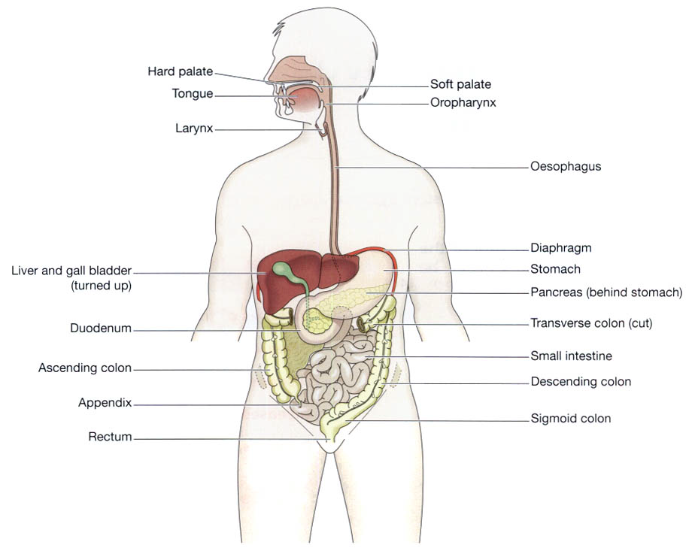
Overview of Anatomy

Slide 3
Activities of GIT are classified as:-
  Ingestion
  Propulsion
  Digestion
  Absorbtion
  Elimination

Slide 4
Alimentary Tract
Consists of:-
  mouth
  pharynx
  oesophagus
  stomach
  small intestine
  large intestine
  rectum and anal canal.

Slide 5
Accessory Organs
Consists of:-
  3 pairs of salivary glands
  pancreas
  liver and the biliary tract.

Slide 6
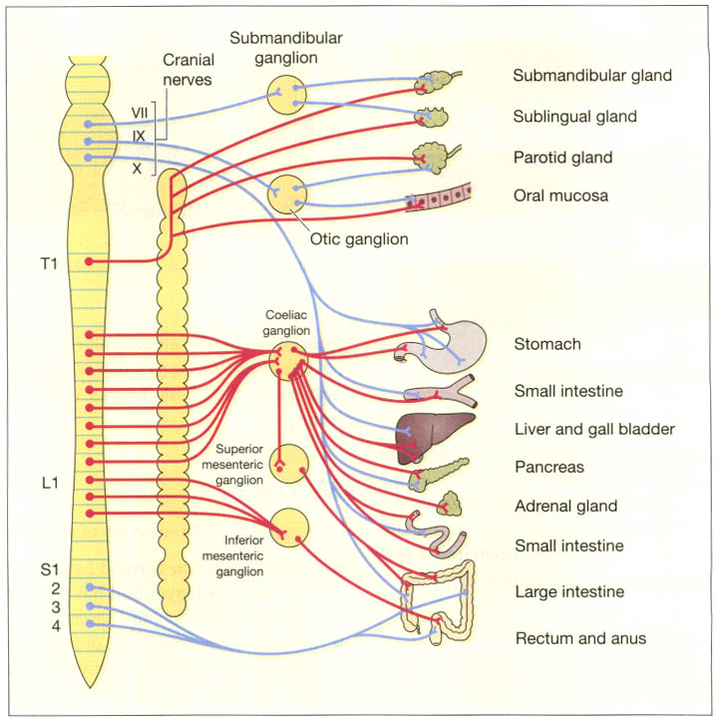
Autonomic Nerve supply

Slide 7
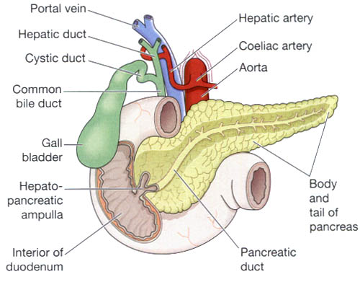
Billiary Tract

Slide 8
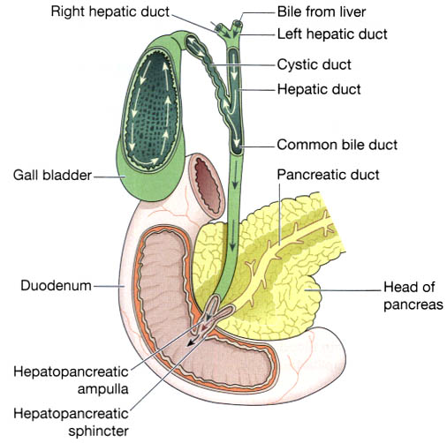
Flow Of Bile

Slide 9
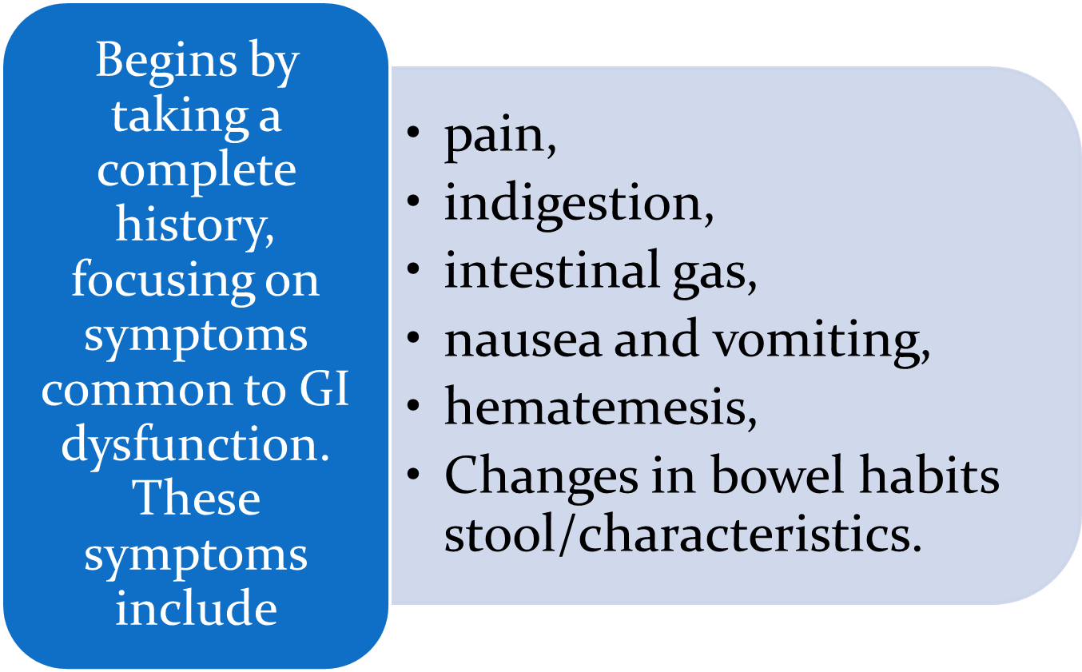
Assessing a patient With GIT Symptoms

Slide 10
Assessing a patient With GIT Symptoms
Note current medication use and any previous treatment or surgery.
Take a dietary history to assess nutritional status.
Record all abnormal findings and report.
Assess psychosocial, spiritual, or cultural factors that may be affecting the patient.

Slide 11
Assessing a patient With GIT Symptoms
Pain
  The character, duration, pattern, frequency, location, distribution of referred pain , and time of the pain vary greatly depending on the underlying cause.
  Other factors, such as meals, rest, defecation, and vascular disorders, may directly affect this pain.

Slide 12
Assessing a patient With GIT Symptoms
Indigestion
  Bowel movements may/ not relieve the pain.
  Indigestion can result from disturbed NS control of the stomach
  Fatty foods tend to cause the most discomfort.
  Coarse vegetables and highly seasoned foods can also cause considerable distress.

Slide 13
Assessing a patient With GIT Symptoms
Intestinal Gas
  The accumulation of gas in the GI tract may result in belching or flatulence.
  Usually, gases in the small intestine pass into the colon and are released as flatus.
  Patients often complain of bloating, distention, or being “full of gas.” Excessive flatulence may be a symptom of gallbladder disease or food intolerance.

Slide 14
Assessing a patient With GIT Symptoms
Nausea and Vomiting
  Vomiting is usually preceded by nausea, which can be triggered by odors, activity, or food intake.
  Vomitus, may vary in color and content. It may contain undigested food particles or blood.

Slide 15
Assessing a patient With GIT Symptoms
Change in Bowel Habits and Stool Characteristics
  Changes in bowel habits may signal colon disease.
  Diarrhea is sometimes associated with abdominal pain or cramping and nausea or vomiting.
  Constipation may be associated with anal discomfort and rectal bleeding.

Slide 16
Assessing a patient With GIT Symptoms
  Stool is normally light to dark brown. However, many circumstances, including the ingestion of certain foods and medications, can change the appearance of stool.
  Blood can present in .If it is shed in sufficient quantities into the upper GI tract, it produces a tarry-black color (melena).
  Blood entering the lower portion of the GI tract or passing with blood rapidly through it will appear bright or dark red.

Slide 17
Assessing a patient With GIT Symptoms
Lower rectal or anal bleeding is suspected if there is streaking of blood on the surface of the stool or if blood is noted on toilet tissue.
Other common abnormalities in stool include the following:
  Bulky, greasy, foamy stools that are foul in odor;

Slide 18
Assessing a patient With GIT Symptoms
  stool color is gray, with a silvery sheen Light gray or clay-colored stool, caused by the absence of urobilin.
  Stool with mucus threads or pus that may be visible on gross inspection of the stool .
  Small, dry, rock-hard masses; sometimes streaked with blood from rectal trauma as they pass through the rectum .
  Loose, watery stool.

Slide 19
Physical Exam
Inspection
Auscultation
Percussion
Palpation

Slide 20
GASTRITIS
Gastritis (inflammation of the gastric or stomach mucosa) is a common GI problem.
Gastritis may be acute, lasting several hours to a few days, or chronic, resulting from repeated exposure to irritating agents or recurring episodes of acute gastritis.

Slide 21
GASTRITIS
Acute gastritis is often caused by dietary indiscretion—the person eats food that is contaminated with disease-causing microorganisms or that is irritating or too highly seasoned.
Other causes of acute gastritis include overuse of aspirin and other NSAIDs, excessive alcohol intake, bile reflux, and radiation therapy.

Slide 22
GASTRITIS
A more severe form of acute gastritis is caused by the ingestion of strong acid or alkali.
Scarring can occur, resulting in pyloric obstruction.
Gastritis also may be the first sign of an acute systemic infection.

Slide 23
Chronic Gastritis
Chronic gastritis and prolonged inflammation of the stomach may be caused by either benign or malignant ulcers of the stomach or by the bacteria Helicobacter pylori.
Chronic gastritis is sometimes associated with autoimmune diseases such as pernicious anemia; dietary factors such as caffeine; the use of medications, especially NSAIDs; alcohol; smoking; or reflux of intestinal contents into the stomach.

Slide 24
Pathophysiology
In gastritis, the gastric mucous membrane becomes edematous and and undergoes superficial erosion.
It secretes a scanty amount of gastric juice, containing very little acid but much mucus.
Superficial ulceration may occur and can lead to hemorrhage

Slide 25
Clinical Features
Acute Gastritis
  Abdominal discomfort,
  headache,
  nausea, anorexia,
  vomiting, and hiccupping.
  Some patients, however, have no symptoms.

Slide 26
Clinical Features
Chronic gastritis
  Anorexia
  heartburn after eating
  belching,
  a sour taste in the mouth
  nausea and vomiting.
  Patients with chronic gastritis from vitamin deficiency usually have evidence of malabsorption of vitamin B12 caused by antibodies against intrinsic factors

Slide 27
Diagnosis
Endoscopy,
Upper GI radiographic studies,
Histologic examination of a tissue specimen obtained by biopsy.
Other diagnostic measures for detecting H. pylori include;
  serologic testing for antibodies against the H. pylori antigen,
  1-minute ultra rapid urease test, and a breath test.

Slide 28
Medical Management
The gastric mucosa is capable of repairing itself after a bout of gastritis.
Instruct the patient to refrain from alcohol and food until symptoms subside.
After the patient can take nourishment by mouth, a non-irritating diet is recommended.

Slide 29
Medical Management
If the symptoms persist, Start iv fluids
If gastritis is caused by ingestion of strong acids or alkalis, treatment consists of diluting and neutralizing the offending agent.
To neutralize acids, common antacids are used; to neutralize an alkali, diluted lemon juice or diluted vinegar is used.

Slide 30
Medical Management
If corrosion is extensive or severe, emetics and lavage are avoided because of the danger of perforation and damage to the esophagus.
Therapy is supportive and may include nasogastric intubation, analgesic s and sedatives, antacids, and intravenous (IV) fluids.

Slide 31
Medical Management
In extreme cases, emergency surgery may be required to remove gangrenous or perforated tissue.
Gastrojejunostomy or gastric resection may be necessary to treat pyloric obstruction, a narrowing of the pyloric orifice.

Slide 32
Medical Management
Chronic gastritis is managed by modifying the patient’s diet, promoting rest, reducing stress, and initiating pharmacotherapy. H. pylori may be treated with antibiotics eg tetracycline amoxicillin, combined with clarithromycin)
A proton pump inhibitor , and possibly bismuth salts (Pepto-Bismol).

Slide 33
Nursing Diagnosis
Anxiety related to treatment
Imbalanced nutrition, less than body requirements, related to inadequate intake of nutrients.
Risk for imbalanced fluid volume related to insufficient fluid intake and excessive fluid loss subsequent to vomiting
Deficient knowledge about dietary management and disease process
Acute pain related to irritated stomach mucosa

Slide 34
Relieving Anxiety
Offers supportive therapy to the patient and family during treatment and after the ingested acid or alkali has been neutralized or diluted.
The nurse uses a calm approach to assess the patient and to answer all questions as completely as possible.
It is important to explain all procedures and treatments according to the patient’s level of understanding.

Slide 35
PROMOTING OPTIMAL NUTRITION
For acute gastritis, provide physical and emotional support and help the patient manage the symptoms, which may include nausea, vomiting, heartburn, and fatigue.
The patient should take no foods or fluids by mouth—possibly for days—until the acute symptoms subside, thus allowing the gastric mucosa to heal.
If IV therapy is necessary, monitor it regularly, along with serum electrolyte values.

Slide 36
PROMOTING OPTIMAL NUTRITION
Introduce solid food as soon as possible to provide oral nutrition, decrease the need for IV therapy, and minimize irritation to the gastric mucosa.
Observe signs of relapse
Discourage the intake of caffeinated beverages, because caffeine is a central nervous system stimulant that increases gastric activity and pepsin secretion.

Slide 37
PROMOTING OPTIMAL NUTRITION
Discourage alcohol use.
Discourage cigarette smoking because nicotine reduces the secretion of pancreatic bicarbonate and thus inhibits the neutralization of gastric acid in the duodenum.

Slide 38
PROMOTING FLUID BALANCE
Monitor daily fluid intake and output to detect early signs of dehydration.
If food and fluids are withheld, IV fluids (3 L/day) usually are prescribed and a record of fluid intake.
Assess electrolyte values (sodium, potassium, chloride) every 24 hours to detect imbalance.

Slide 39
PROMOTING FLUID BALANCE
Be alert for any indicators of hemorrhagic gastritis, which include hematemesis (vomiting of blood), tachycardia, and hypotension.
If these occur, the physician is notified and the patient’s vital signs are monitored as the patient’s condition Warrants.

Slide 40
RELIEVING PAIN
Instruct the patient to avoid foods and beverages that may be irritating to the gastric mucosa.
Assesses the patient’s level of pain and the extent of comfort attained from the use of medications and avoidance of irritating substances

Slide 41
Peptic Ulcers
A peptic ulcer is an excavation that forms in the mucosal wall of the stomach, in the pylorus, in the duodenum, or in the esophagus.
  gastric
  Duodenal
  esophageal ulcer
This erosion may extend as deeply as the muscle layers or through the muscle to the peritoneum.

Slide 42
Peptic Ulcers
Peptic ulcers are more likely to be in the duodenum than in the stomach.
They occur alone, but they may occur in multiples.
Chronic gastric ulcers tend to occur in the lesser curvature of the stomach, near the pylorus.

Slide 43
Peptic Ulcers
Prevalence is greater in people between the ages of 40 and 60 years.
It is relatively uncommon in women of childbearing age, but it has been observed in children and even in infants.
Peptic ulcers in the body of the stomach can occur without excessive acid secretion

Slide 44
Predisposing Factors
H. pylori
Excessive secretion of HCl in the stomach may
Stress may increase HCL Secretion.
The ingestion of milk and caffeinated beverages, smoking, and alcohol also may increase HCl secretion.
Familial tendency.

Slide 45
Predisposing Factors
Genetic link is noted in the finding that people with blood type O are more susceptible to peptic ulcers than are those with blood type A, B, or AB.
There also is an association between duodenal ulcers and chronic pulmonary disease or chronic renal disease.
Chronic use of NSAIDs, alcohol ingestion, and excessive smoking.

Slide 46
Predisposing Factors
Excessive amounts of the hormone gastrin, produced by tumors (Rarely).
Zollinger-Ellison syndrome (ZES) (consists of severe peptic ulcers
  Extreme gastric hyperacidity
  Gastrin-secreting benign or malignant tumors of the pancreas).
gastroesophageal reflux disease (GERD).

Slide 47
Pathophysiology
Peptic ulcers occur mainly in the gastroduodenal mucosa because this tissue cannot withstand the digestive action of gastric acid and pepsin.
The erosion is caused by the increased concentration or activity of acid-pepsin, or by decreased resistance of the mucosa.

Slide 48
Pathophysiology
A damaged mucosa cannot secrete enough mucus to act as a barrier against HCl.
Patients with duodenal ulcer disease secrete more acid than normal, whereas patients with gastric ulcer tend to secrete normal or decreased levels of acid.

Slide 49
Pathophysiology
Duodenal Ulcers
  H. pylori and NSAID-induced injury account for the majority of DUs. The average basal and nocturnal gastric acid secretion appears to be increased in DU. H. pylori infection may contribute.
  Bicarbonate secretion is significantly decreased in the duodenal bulb of patients with an active DU. H. pylori infection may also play a role in this process.

Slide 50
Pathophysiology
Gastric Ulcers
  H. pylori or NSAID-induced mucosal damage. GUs that occur in the prepyloric area or those in the body associated with a
  Gastric acid output (basal and stimulated) tends to be normal or decreased in GU patients.
  When GUs develop in the presence of minimal acid levels, impairment of mucosal defense factors may be present.

Slide 51
Clinical Features
Symptoms of an ulcer may last for a few days, weeks, or months and may disappear only to reappear, often without an identifiable cause.
Many people have symptomless ulcers, and in 20% to 30% perforation or hemorrhage may occur without any preceding manifestations.

Slide 52
Clinical Features
Gnawing or burning epigastric pain occurring ½ to 3 hours after a meal
Nocturnal epigastric, abdominal pain or burning. May awaken patient at night, usually around midnight to 3 a.m.

Slide 53
Clinical features
Epigastric tenderness on examination
Early satiety, anorexia
weight loss
Heartburn
belching (may indicate reflux disease)
Dizziness
Syncope, hematemesis, or melena (may indicate hemorrhage)
Anemia

Slide 54
Diagnosis
Upper GI endoscopy with possible tissue biopsy and cytology.
Pyloritek, a biopsy urea test, is up to 95% specific in detecting H. pylori.
barium study
Serial stool specimens to detect occult blood
Serology to test for H. pylori antibodies
C or C-urea breath test to detect H. pylori

Slide 55
Difference Between DU and GU
DU
GU
Age 30–60
Male: female 2–3:1
80% of peptic ulcers DU
Hypersecretion of HCl
May have weight gain
50 and over
Male: female 1:1
15% of peptic ulcers GU
HCL either normal or Hyposecretion
Weight loss likely

Slide 56
Difference Between DU and GU
DU
GU
Pain occurs 2–3 hours after a meal; often awakened between 1–2 AM;
Ingestion of food relieves pain
Pain occurs 1⁄2 to 1 hour after a meal; rarely occurs at night
Pain is relieved by vomiting
Food may worsen pain

Slide 57
Difference Between DU and GU
DU
GU
Vomiting uncommon
Hemorrhage less likely than with GU
More likely to perforate than GU
Vomiting is common
Hemorrage likely
Less likely to perforate

Slide 58
Difference Between DU and GU
DU
GU
Risk Factors H. pylori, alcohol, smoking, cirrhosis and stress
Risk factors include H. pylori, gastritis, alcohol, smoking, use of NSAIDs, stress

Slide 59
Management
Pharmacotherapy
  Proton pump inhibitors, H2 receptor blockers upto a year
  Antibiotics
  Bismuth salt
  Antiacids and tranquilizers may also be prescribed
Stress reduction and rest
Cessation of smoking
Dietary modification
  Avoid GI irritants
  Eat 3 regular meals a day
  Avoid foods that produce pain

Slide 60
Surgery
Surgery is usually recommended for patients with
  Intractable ulcers (those that fail to heal after 12 to 16 weeks of medical treatment)
  life-threatening hemorrhage
  Perforation
  obstruction,
  ZES not responding to medications.
Include vagotomy

Slide 61
Nursing Care
The goals of care should include:
    Reduction of pain and discomfort
    Reduction in complications
    Complete healing of the peptic ulcer
    Changes in the lifestyle which led to the ulcer
    Compliance with management regime

Slide 62
Nursing Care
Conservative management is done by giving the patient
  adequate bed rest
  bland diet of six small meals a day
  Stress reduction.
The patient should cease smoking.
Monitor vital signs especially pulse and BP
Monitor For complications

Slide 63
Complications
Haemorrhage, Malena or hematemesis
Perforation and penetration
Pyloric obstruction

Slide 64
Complications
Surgery related complications
  Recurrent Ulcerations
  Dumping syndrome
  Afferent loop Syndrome
    postprandial abdominal pain
    bloating, and diarrhea with concomitant malabsorption of fats and vitamin B₁₂.

Slide 65
Intestinal Obstruction
Intestinal obstruction occurs when a blockage obstructs the normal flow of contents through the intestinal tract.
Obstruction of the intestine causes the bowel to become vulnerable to ischemia.
The intestinal mucosal barrier can be damaged, thus allowing intestinal bacteria to invade the intestinal wall and causing fluid exudation, which leads to hypovolemia and dehydration.

Slide 66
Intestinal Obstruction
About 7 L of fluid per day is secreted into the small intestine and stomach and usually reabsorbed.
During obstruction, however, fluid accumulates, causing abdominal distension and pressure on the mucosal wall, which can lead to peritonitis and perforation.

Slide 67
Causes
Can be mechanical or neurogenic, partial or complete
Small intestinal obstruction
  Adhesions (80% in adults)
  Hernias
  Crohn’s disease
  Intussusception
  cancer

Slide 68
Causes
    Intestinal worms especially in children
    Paralytic ileus
Colonic obstruction
  Carcinoma of the colon
  Sigmoid volvulus
  Diverticular disease
  Fecal impaction

Slide 69
Clinical Features
Abdominal colic, vomiting and constipation without passage of wind.
In upper GUT obstruction the vomiting is profuse but in lower gut obstruction it may be absent.
Examination of the abdomen reveals distension with increased bowel sounds.

Slide 70
Clinical features
Marked tenderness suggests strangulation, and urgent surgery is necessary.
Examination of the hernial orifices and rectum must be performed.
X-ray of the abdomen reveals distended loops of bowel proximal to the obstruction.

Slide 71
Diagnosis
Plain Abd X-ray
  Fluid levels are seen in small bowel obstruction on an erect film.
  In large bowel obstruction, the caecum and ascending colon are distended.
CT can localize the lesion accurately and is the investigation of choice.

Slide 72
Management
Initial management is by resuscitation with intravenous fluids and decompression by use of NGT.
NPO
Many cases will settle on conservative management, but an increasing temperature, raised pulse rate, increasing pain and a rising white cell count require urgent scanning and possible exploratory laparotomy.

Slide 73
Management
Laparotomy with removal of the obstruction.
If the bowel is gangrenous owing to strangulation, gut resection will be required.
In large bowel obstruction due to malignancy, colorectal stents can be used, followed by elective surgery.

Slide 74
Management
In critically ill patients, a colostomy may be required.
Volvulus of the sigmoid colon can be managed by the passage of a flexible sigmoidoscope or a rectal tube to un-kink the bowel, but recurrent volvulus may require sigmoid resection.
Vital signs
Pain relief

Slide 75
Appendicitis
This is the most common surgical emergency. It affects all age groups.
Appendicitis should always be considered in the differential diagnosis if the appendix has not been removed.

Slide 76
Appendicitis
Acute appendicitis mostly occurs when the lumen of the appendix becomes obstructed with a faecolith;
In some cases there is only generalized acute inflammation.
If the appendix is not removed at this stage, gangrene occurs with perforation, leading to a localized abscess or to generalized peritonitis.

Slide 77
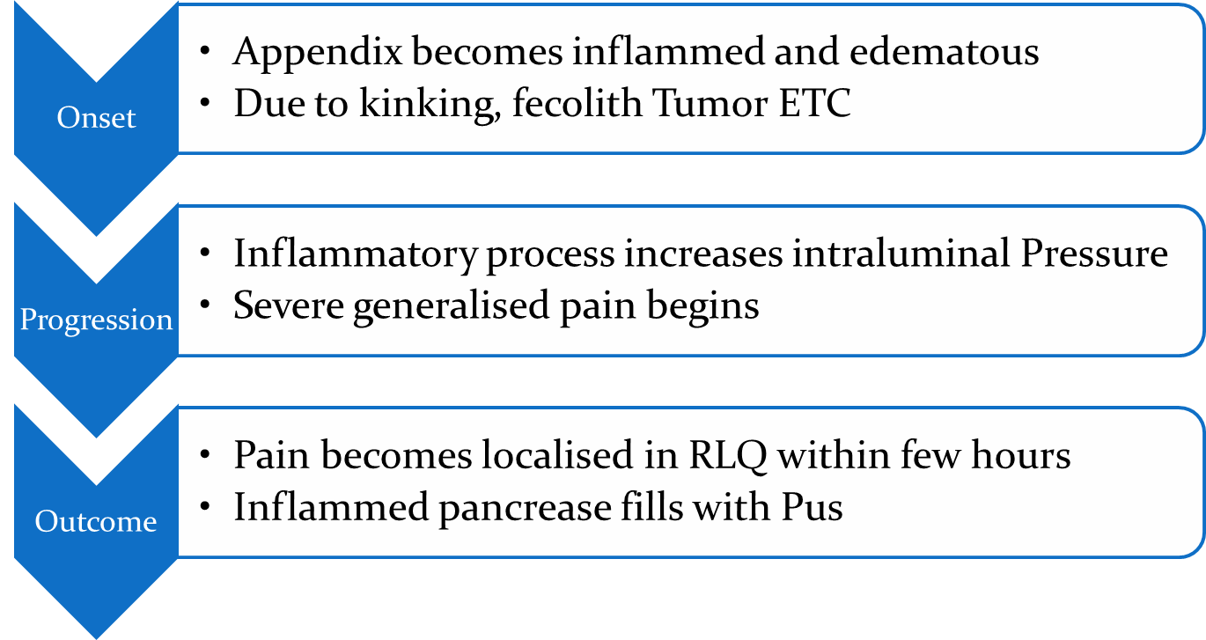
Pathophysiology

Slide 78
Clinical features
Generalized or localized abdominal pain in the epigastric or periumbilical areas and upper right abdomen.
Within 2 to 12 hours, the pain localizes in the right lower quadrant and intensity increases.
Anorexia, moderate malaise, mild fever, nausea and vomiting.
Usually constipation occurs; occasionally diarrhea.
Rebound tenderness, involuntary guarding, generalized abdominal rigidity.

Slide 79
Diagnosis
Physical examination consistent with clinical manifestations.
WBC count reveals moderate leukocytosis (10,000 to 16,000/mm³) with shift to the left (increased immature neutrophils).
Urinalysis to rule out urinary disorders.

Slide 80
Diagnosis
Abdominal X-ray may visualize shadow consistent with fecalith in appendix; perforation will reveal free air.
Abdominal ultrasound or CT
Focused appendiceal CT can quickly evaluate for appendicitis.

Slide 81
Differential Diagnosis
Non-specific mesenteric lymphadenitis – may mimic appendicitis.
Acute terminal ileitis due to Crohn’s disease or Yersinia infection.
Gynaecological causes.
Inflamed Meckel’s diverticulum.
Functional bowel disease.

Slide 82
Management
Surgery is indicated if appendicitis is diagnosed.
To correct or prevent fluid and electrolyte imbalance and dehydration, antibiotics and intravenous fluids are administered until surgery is performed.
Analgesics can be administered after the diagnosis is made.
Appendectomy is performed as soon as possible to decrease the risk of perforation.

Slide 83
Management
It may be performed under a general or spinal anesthetic with a low abdominal incision or by laparoscopy.
Prepare the patient for surgery.
If there is evidence or likelihood of paralytic ileus, a nasogastric tube is inserted.

Slide 84
Management
An enema is not administered because it can lead to perforation.
After surgery, place the patient in a semi-Fowler position. To reduce the tension on the incision and abdominal organs, helping to reduce pain.
An opioid, usually morphine sulfate, is prescribed to relieve pain.

Slide 85
Management
When tolerated, administer oral fluids.
Any patient who was dehydrated before surgery receives intravenous fluids.
The patient may be discharged on the day of surgery if the temperature is within normal limits, there is no undue discomfort in the operative area, and the appendectomy was uncomplicated.

Slide 86
Management
Remove the sutures between the fifth and seventh days after surgery.
Normal activity can usually be resumed within 2 to 4 weeks.
If there is a possibility of peritonitis, a drain is left in place at the area of the incision.

Slide 87
Complications
Peritonitis
Pelvic abscess
Subphrenic abscess (abscess under the diaphragm)
Ileus (paralytic and mechanical)
Perforation

Slide 88
Hernias
A hernia is a protrusion of an organ, tissue, or structure through the wall of the cavity in which it is normally contained.
There are several types of hernia including
  Inguinal hernia
  Umbilical hernia
  Hiatus hernia

Slide 89
Hernias
Hernias are classified into three types:
  reducible, which can be easily manipulated back into place manually;
  irreducible or incarcerated, which cannot usually be reduced manually because adhesions form in the hernial sac;
  strangulated, in which part of the herniated intestine becomes twisted or edematous, possibly resulting in intestinal obstruction and necrosis.

Slide 90
Hiatus Hernia
The stomach herniates through the diaphragm into the thoracic cavity.
The hiatus hernia results in reflux of gastric contents and symptoms like those of oesophagitis will ensue.
Congenitally weak muscles, obesity, pregnancy, tight fitting clothes and other conditions that raise the intra abdominal pressure contribute to it.

Slide 91
Hiatus Hernia
Hiatus hernia leads to gastro-oesophageal reflux disease and the management will entail the same measures.
The patient should also avoid constricting clothes and heavy lifting.

Slide 92
Clinical features
May be asymptomatic
Heartburn (with or without regurgitation of gastric contents into the mouth)
Dysphagia, chest pain

Slide 93
Diagnosis
Barium study of the esophagus outlines hernia.
Endoscopic examination visualizes defect.

Slide 94
Management
Elevation of head of [15 to 20 cm] to reduce night time reflux.
Antacid therapy to neutralize gastric acid.
H₂-receptor antagonist (cimetidine, ranitidine) if patient has esophagitis.
Surgical repair of hernia if symptoms are severe.

Slide 95
Complications
Aspiration of reflux contents
Ulceration, hemorrhage
Gastritis
Stricture
Incarceration of the portion of the stomach in the chest

Slide 96
Inguinal Hernia
An inguinal hernia occurs when either the omentum, the large or small intestine, or the bladder protrudes into the inguinal canal.
  Can be direct
  Or indirect
Indirect inguinal hernia, the sac protrudes through the internal inguinal ring into the inguinal canal and, in males, may descend into the scrotum.

Slide 97
Inguinal Hernia
Direct inguinal hernia, the hernial sac projects through a weakness in the abdominal wall in the area of the rectus abdominal muscle and inguinal ligament.
Inguinal hernias make up approximately 80% of all hernias.

Slide 98
Causes
Congenital weakening of the abdominal wall.
weakened abdominal muscles because of
    Pregnancy
    Excess weight
    previous abdominal surgeries.
Increased intra-abdominal pressure
    Heavy lifting
    Straining to defecate.
Other causes include aging and trauma

Slide 99
INFLAMMATORY BOWEL DISEASES
CHRON’S DISEASE
ULCERATIVE COLITIS

Slide 100
CHRON’S DISEASE(REGIONAL ENTERITIS
Commonly occurs in adolescents or young adults but can appear at any time of life.
It is more common in women, and it occurs frequently in the older population (between the ages of 50 and 80).

Slide 101
CHRON’S DISEASE(REGIONAL ENTERITIS
It can occur anywhere along the GI tract, but the most common areas are the distal ileum and colon.
Crohn’s disease is seen two times more often in patients who smoke than in nonsmokers.

Slide 102
Pathophysiology
Subacute and chronic inflammation that extends through all layers (ie, transmural lesion) of the bowel wall from the intestinal mucosa.
The disease process begins with edema and thickening of the mucosa. Ulcers begin to appear on the inflamed mucosa.

Slide 103
PATHOPHYSIOLOGY
These lesions are not in continuous contact with one another and are separated by normal tissue.
Fistulas, fissures, and abscesses form as the inflammation extends into the peritoneum.

Slide 104
Pathophysiology
As the disease advances, the bowel wall thickens and becomes fibrotic, and the intestinal lumen narrows.
Diseased bowel loops sometimes adhere to other loops surrounding them

Slide 105
CLINICAL FEATURES
Crampy intermittent pain
Chronic diarrhea usual consistency is soft or Semiliquid.
Bloody stools or steatorrhea (due to malabsorption) may occur.
Fever may indicate infectious complication such as abscess.

Slide 106
CLINICAL FEATURES
Fecal urgency and tenesmus.
Anorexia, weight loss, malaise, nausea, arthralgias, and hematochezia(Fresh blood through anus).
Rectal examination may reveal a perirectal abscess, fistula, fissure, or skin tags (which represent healed perianal lesions).

Slide 107
Diagnosis
CBC may show mild leukocytosis, thrombocytosis, anemia.
Hypoalbuminemia.
Stool analysis may reveal leukocytes but no enteric pathogens.
Upper GI and small-bowel follow-through barium studies may show the classic string sign at the terminal ileum, which suggests a constriction of an intestinal segment.

Slide 108
Diagnosis
A barium enema may permit visualization of lesions in the large intestine and terminal ileum.
CT scan of the abdomen and pelvis
Colonoscopy is the procedure of choice.
Biopsy.

Slide 109
Ulcerative colitis
Ulcerative colitis is a recurrent ulcerative and inflammatory disease of the mucosal and submucosal layers of the colon and rectum.
The peak incidence is between 30 and 50 years of age.

Slide 110
Ulcerative colitis
It is a serious disease, accompanied by systemic complications and a high mortality rate.
Eventually, 10% to 15% of the patients develop carcinoma of the colon.

Slide 111
Pathophysiology
Ulcerative colitis affects the superficial mucosa of the colon and is characterized by multiple ulcerations, diffuse inflammations, and desquamation or shedding of the colonic epithelium.
Bleeding occurs as a result of the ulcerations.
The mucosa becomes edematous and inflamed.

Slide 112
Pathophysiology
Abscesses form, and infiltrate is seen in the mucosa and sub-mucosa with clumps of neutrophils in the crypt
The disease process usually begins in the rectum and spreads proximally to involve the entire colon.
Eventually, the bowel narrows, shortens, and thickens because of muscular hypertrophy and fat deposits.

Slide 113
Clinical Features
Diarrhea may be bloody or contain pus and mucus.
Tenesmus (painful straining), sense of urgency, and frequency.
Increased bowel sounds.

Slide 114
Clinical Features
Weight loss, fever, dehydration, hypokalemia, anorexia, nausea and vomiting,
Iron-deficiency anemia, and cachexia (general lack of nutrition and wasting with chronic disease).
Crampy abdominal pain.

Slide 115
Clinical Features
Anal area may be irritated and reddened; left lower abdomen may be tender on palpation.
Increased risk of developing colorectal cancer.
May inhibit extracolonic manifestations of eye (iritis, uveitis), joint (polyarthritis), and skin complaints (erythema nodosum, pyoderma gangrenosum).

Slide 116
Diagnosis
Stool examination to rule out enteral pathogens.
Complete blood count hemoglobin and hematocrit may be low due to bleeding; WBC may be increased.
Decreased serum levels of potassium, magnesium, and albumin may be present.

Slide 117
Diagnosis
Barium enema
Proctosigmoidoscopy/colonoscopy
CT scan can identify complications such as toxic megacolon.
Rectal biopsy differentiates from other inflammatory diseases or cancer

Slide 118
Management
Medical treatment for regional enteritis and ulcerative colitis is aimed at:
    Reducing inflammation
    suppressing inappropriate immune responses,
    providing rest for a diseased bowel so that healing may take place.
    Improving quality of life
    Preventing or minimizing complications.

Slide 119
Management
Management depends on the disease location, severity, and complications.
Oral fluids and a low-residue, high-protein, high-calorie diet with supplemental vitamin therapy and iron replacement, to meet nutritional needs, reduce inflammation, and control pain and diarrhea.

Slide 120
Management
Fluid and electrolyte imbalances from dehydration caused by diarrhea are corrected by intravenous therapy as necessary
Any foods that exacerbate diarrhea are avoided.
Cold foods and smoking are avoided because both increase intestinal motility.
Parenteral nutrition may be indicated.

Slide 121
Management
Sedatives and antidiarrheal medications are used to minimize peristalsis to rest the inflamed bowel.
Antibiotics are used for secondary infections,
Corticosteroids are used to treat severe and fulminant disease.

Slide 122
Management
Immunomodulators (methotrexate, cyclosporin) have been used to alter the immune response.
They are used for patients with severe disease who have failed other therapies.
These medications are useful in maintenance regimens to prevent relapses.

Slide 123


Slide 124
Billiary Tract

Slide 125
Pancreatitis
Pancreatitis is divided into acute and chronic.
By definition acute pancreatitis is a process that occurs on the background of a previously normal pancreas and can return to normal after resolution of the episode.
In chronic pancreatitis there is continuing inflammation with irreversible structural changes.

Slide 126
Acute pancreatitis
The causes of acute pancreatitis are
  Gallstones, Alcohol,
  Infections (e.g. mumps,Coxsackie B)
  Pancreatic tumours,
  Drugs (e.g corticosteroids,didanosine)
  Iatrogenic (e.g. post-surgical,)
  Hyperlipidaemias,
  Trauma, Scorpion bite
  Cardiac surgery, Idiopathic,
  pancreatic enzymes.

Slide 127
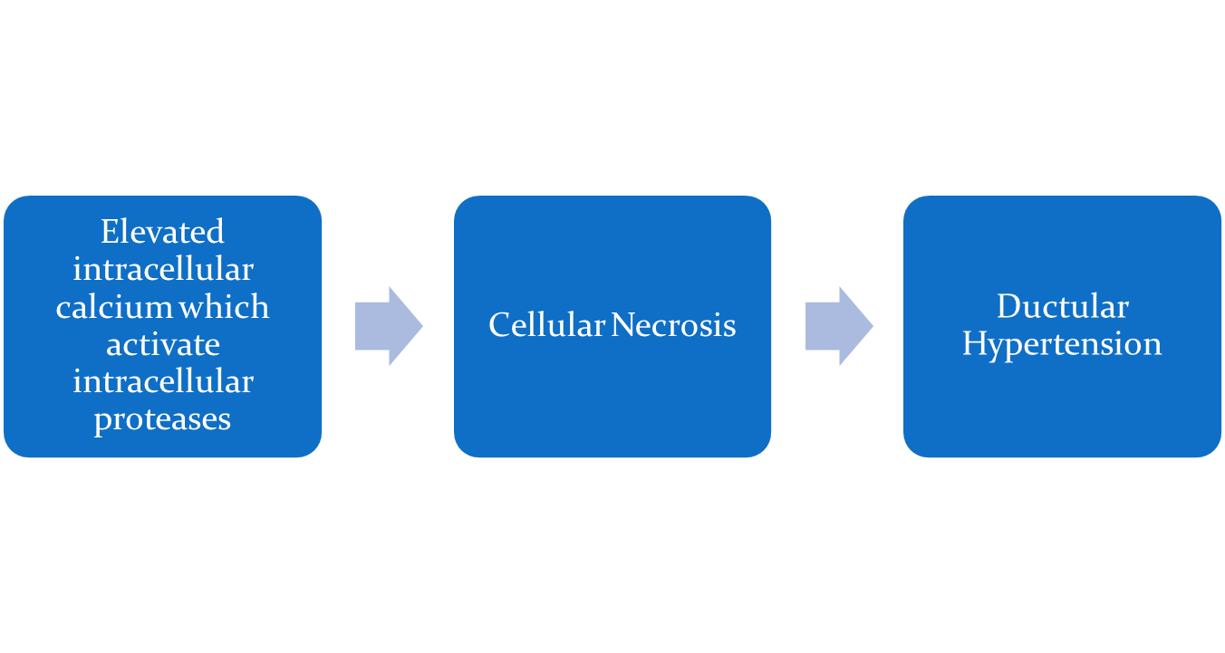
Pathogenesis

Slide 128
Clinical Features
Abdominal pain, usually constant, midepigastric or periumbilical, radiating to the back or flank.
Patient leans forward while sitting to relieve pressure of the inflamed pancreas on celiac plexus nerves.
Pain can be mild to incapacitating.

Slide 129
Clinical Features
Nausea and vomiting.
Fever.
Involuntary abdominal guarding, epigastric tenderness to deep palpation, and reduced or absent bowel sounds.
Features of Dehydration

Slide 130
Clinical features
Shock may be the presenting manifestation in severe episodes, with respiratory distress and acute renal failure.
Purplish discoloration of the flanks (Turner's sign) or of the peri-umbilical area (Cullen's sign) occurs in extensive hemorrhagic necrosis of the pancreas.

Slide 131
Diagnosis
Blood tests
  Serum amylase is an extremely when measured within 24 hours of the onset of pain.
  Amylase levels gradually fall back towards normal over the next 3–5 days.
  With a late presentation the serum amylase level may give a false-negative result.
  Serum lipase are raised in acute pancreatitis and remain elevated for a longer period of time than those of amylase.

Slide 132
Diagnosis
The accuracy of serum lipase is not significantly greater than.
  Other baseline investigations include
  a full blood count,
  urea and electrolytes,
  blood glucose,

Slide 133
Diagnosis
  liver biochemistry,
  plasma calcium
  arterial blood gases. These are documented Baseline then repeated at 24 and 48 hours and provide a basis for assessing the severity of an attack.
Urine
  Urinary amylase levels may be diagnostic as these remain elevated over a longer period of time.

Slide 134
Diagnosis
Chest x-ray
CT-Scan
MRI
Abdominal Ultrasound

Slide 135
Management
Start IVF and monitor fluid input and output,
Daily weight.
Measure abdominal girth if ascites is present.
Nasogastric suction prevents abdominal distension and vomitus.
Baseline arterial blood gases determine the need for continuous oxygen administration.

Slide 136
Management
Prophylactic antibiotics. Broad-spectrum antibiotics, e.g. cefuroxime, or aztreonam,
Analgesia requirements. Pethidine and tramadol are the drugs of choice for immediate post-presentation pain control.

Slide 137
Management
Feeding. In patients with a severe episode NPO for a number of weeks.
Frequent oral care
NGT feeding when symptoms resolve
low molecular weight heparin for DVT prophylaxis.
H2 receptor blockers

Slide 138
Complications
Pancreatic ascites, abscess, or pseu-docyst.
Pulmonary infiltrates, pleural effusion, acute respiratory distress syndrome.
Haemorrhage with hypovolemic shock.
Acute renal failure.
Sepsis and multiple-organ dysfunction syndrome.

Slide 139
Chronic Pancreatitis
The most common cause of chronic pancreatitis is alcohol, accounting for 60–80% of cases.
Other Causes
  Hereditary
  Trypsinogen
  Inhibitory protein,
  Cystic fibrosis,
  Idiopathic,
  Trauma,
  Hyper-calcaemia.

Slide 140

Pathogenesis
Alcohol
Autoactivation
Genetic abnormality
Activation Of Enzymes within the pancrease
Reduced inhibitor protein and increased enzyme activity
Damaged Pancrease
Plugs form within the Lumen Leading to ductal Obstruction

Slide 141
Clinical features
Pain is usually located in the epigastrium or left upper quadrant, frequently radiating to the back;
Recurring attacks of pain will be more severe, more frequent, and of longer duration.
Weight loss, nausea, vomiting, anorexia.
Malabsorption and steatorrhea occur late in the course of the disease.
Diabetes mellitus.

Slide 142
Diagnosis
Serum amylase and lipase may be normal to low because of decreased pancreatic exocrine function.
Fecal fat analysis determines need for pancreatic enzyme replacement.
Bilirubin and alkaline phosphatase may be elevated if biliary obstruction occurs.

Slide 143
Diagnosis
Secretin and cholecystokinin stimulatory test results abnormal.
Plain abdominal X-ray to determine diffuse calcification of the pancreas.
CT scan identifies pancreatic structural changes, such as calcifications, masses, ductal irregularities, enlargement, and pseudocysts.

Slide 144
Management
Pain management.
Correction of nutritional deficiencies.
Pancreatic enzyme replacement.
Treatment of diabetes mellitus.
Surgical interventions to reduce pain, restore drainage of pancreatic secretions, correct structural abnormalities, and manage complications. Care is similar to the patient undergoing abdominal surgery
PPI or H2 antagonists
Stop alcohol intake.

Slide 145
Complications
Pancreatic pseudocyst.
Pancreatic ascites and pleural effusions.
GI hemorrhage.
Biliary tract obstruction.
Pancreatic fistula.

Slide 146


Slide 147
Flow Of Bile

Slide 148
Cholecystitis
Acute inflammation of the gallbladder causes pain, tenderness, and rigidity of the upper right abdomen that may radiate to the mid-sternal area or right shoulder and is associated with nausea, vomiting, and the usual signs of an acute inflammation.

Slide 149
Cholecystitis
An empyema of the gallbladder develops if the gallbladder becomes filled with purulent fluid.
Gallstone is the cause of more than 90% of cases of acute cholecystitis.
Gallbladder stone obstructs bile outflow.

Slide 150
Cholesystitis
Bile remaining in the gallbladder initiates a chemical reaction;
  autolysis and edema occur;
  Blood vessels in the gallbladder are compressed, compromising its vascular supply.
Gangrene of the gallbladder with perforation may result.

Slide 151
Cholecystitis
Bacteria play a minor role in acute cholecystitis; Escherichia coli, Klebsiella species, and other enteric organisms occurs in about 60% of pt.
Other factors associated with this type of cholecystitis include
  torsion,
  cystic duct obstruction,
  primary bacterial infections of the gallbladder,
  multiple blood transfusions.

Slide 152
Cholecystitis
It is speculated that acalculous cholecystitis results from;
    alterations in fluids and electrolytes and in regional blood flow in the visceral circulation.
    Bile stasis (lack of gallbladder contraction)
    Increased viscosity of the bile.

Slide 153
Causes
Gallstones blocking cystic duct
Ischemic damage to the gallbladder, critically ill patient (acalculous cholecystitis)
Infectious agents, especially in patients with AIDS (cytomegalovirus, Cryptosporidium)
Strictures of the bile duct
Neoplasms, primary or metastatic

Slide 154
Clinical Features
Pain and tenderness in the right hypochondrium or epigastrium; pain may radiate to the infrascapular region.
Palpation of the right upper quadrant elicits marked tenderness and stoppage of inspired breath (Murphy's sign).
Guarding, fever (33% of patients)

Slide 155
Clinical Features
Jaundice. Cystic duct stone obstructing common bile duct can cause jaundice (Mirizzi's syndrome)
Palpable gallbladder
Nausea and vomiting
Ingestion of large, fatty meals before the onset of pain.

Slide 156
Diagnosis
Leukocytosis (12,000–20,000/mm³) is present in more than 70% of patients.
Elevated alkaline phosphatase, ALT, AST, bilirubin levels;
Elevated amylase may be present (consider pancreatitis if serum amylase exceeds 500 U).
No single clinical finding or laboratory test is sufficient to establish or exclude cholecystitis without further testing

Slide 157
Diagnosis
Ultrasonography of the Abdomen
CT scan of abdomen
Plain film of the abdomen generally is not useful, because <25% of stones are radiopaque.

Slide 158
Management
Cholecystectomy (laparoscopic is preferred);
conservative management IVF
Antibiotics
Stone extraction can be performed
Nursing care
  General Pre and Post Op care
  Pain control
  Health Education
    Diet

Slide 159
Viral Hepatitis
Acute parenchymal liver damage can be caused by many agents.
Chronic hepatitis is defined as any hepatitis lasting for 6 months or longer and is often classified according to the Aetiology.
Chronic viral hepatitis is the principal cause of chronic liver disease, cirrhosis and hepatocellular carcinoma world-wide.

Slide 160
Hepatitis A
Hepatitis A is the most common type of viral hepatitis occurring world-wide, often in epidemics.
The disease is commonly seen in children and young adults.
Spread of infection is mainly by the faeco-oral route.
There is no carrier state.

Slide 161
Hepatitis A
HAV is a picornavirus.
It has a single serotype.
It replicates in the liver, is excreted in bile and is then excreted in the faeces of infected persons for about 2 weeks before the onset of clinical illness and for up to 7 days after.

Slide 162
Hepatitis A
The disease is maximally infectious just before the onset of jaundice.
HAV particles can be demonstrated in the faeces by microscopy.
Incubation is 15-42 days

Slide 163
Clinical features
May have no symptoms.
Pre-icteric phase: Fatigue, anorexia, malaise, head-ache, low-grade fever, nausea, and vomiting.
Icteric phase: jaundice, tea-colored urine, clay-colored stool, and right upper quadrant tenderness.

Slide 164
Hepatitis B
The hepatitis B virus (HBV) is present world-wide with 10–20% in parts of Africa, the Middle and the Far East.
Vertical transmission from mother to child in utero, during parturition or soon after birth, is the usual means of transmission world-wide.
HBV is not transmitted by breast feeding.

Slide 165
Hepatitis B
Horizontal transmission occurs particularly in children through minor abrasions or close contact with other children.
HBV can survive on household articles, e.g. toys, toothbrushes, for prolonged periods so transmission may be possible.

Slide 166
Hepatitis B
HBV spread also occurs by the intravenous route or by close personal contact, such as during sexual intercourse,
The virus can be found in semen and saliva.
Incubation period 42-160 Days

Slide 167
Clinical Features
Symptom onset usually more insidious and prolonged compared with HAV.
May be asymptomatic.
One week to 2 months of prodromal symptoms:
  Fatigue, anorexia,
  Transient fever, abdominal discomfort,
  Nausea and vomiting, headache.

Slide 168
Clinical Features
Extrahepatic manifestations may include;
  Myalgias, photophobia,
  Arthritis, angioedema,
  Urticaria, skin rashes, vasculitis.
Jaundice in icteric phase.
In rare cases, hepatic failure, also called fulminant hepatitis.

Slide 169
Hepatitis C
Hepatitis C (HCV) was formerly called non-A, non-B hepatitis; an RNA virus.
Mode of transmission in most cases is through blood or blood products;
  Found among I.V. drug users and renal dialysis patients.
  Can be transmitted through sexual intercourse.

Slide 170
Hepatitis C
Incubation period varies from 14-160 Days.
Occurs in all age-groups.
  Most common form of post transfusion hepatitis.
  May occur sporadically or in epidemic proportions.

Slide 171
Clinical features
Similar to those associated with HBV but usually less severe.
Symptoms usually occur 6 to 7 weeks after transfusion but may be attributed to another viral infection and not diagnosed as hepatitis.
Approximately 50% develop chronic liver disease and at least 20% progress to cirrhosis

Slide 172
Hepatitis D
Hepatitis D virus (HDV) is a defective RNA agent that appears to replicate only with the hepatitis B virus. It requires HBsAg to replicate.
  Occurs along with HBV or may superinfect a chronic HBV carrier.
  Cannot outlast a hepatitis B infection.
  May be acute or chronic.

Slide 173
Hepatitis D
Mode of transmission the same as for HBV.
Incubation 28-49 Days
Occurrence is primarily among I.V. drug abusers or multiply-transfused patients.
Mortality causes about 50% of fulminant hepatitis, which has a high mortality

Slide 174
Clinical Features
Similar to HBV but more severe.
With super-infection of chronic HBV carriers, causes sudden worsening of condition and rapid progression of cirrhosis.

Slide 175
Diagnosis
Elevated serum transferase levels (aspartate transaminase [AST], alanine transaminase [ALT]) for all forms of hepatitis.
Radio-immunoassays that reveal immunoglobulin (Ig) M antibodies to hepatitis virus in the acute phase of HAV.
Radioimmunoassays to include HBsAg, anti-HBc, anti-HBsAg detected in various stages of HBV

Slide 176
Diagnosis
Hepatitis C antibody may not be detected for 3 to 6 months after onset of HCV illness; antibody test used for screening purposes.
Hepatitis E antigen (with HCV ruled out).
Liver biopsy to detect chronic active disease, progression, and response to therapy.

Slide 177
Management
Rest according to patient's level of fatigue.
Therapeutic measures to control dyspeptic symptoms and malaise.
Hospitalization for protracted nausea and vomiting or life-threatening complications.

Slide 178
Management
Small, frequent feedings of a high-caloric, low-fat diet;
proteins are restricted when the liver cannot metabolize protein by-products.
Vitamin K injected subcutaneously if PT is prolonged.

Slide 179
Management
I.V. fluid and electrolyte replacement
Administration of antiemetic for nausea.
After jaundice has cleared, gradual increase in physical activity. This may require many months.

Slide 180
Complications
Dehydration, hypokalemia.
Chronic carrier hepatitis or chronic active hepatitis.
Cholestatic hepatitis.
Fulminant hepatitis (liver transplantation may be necessary).
HBV and HCV carriers have a higher risk of developing hepatocellular carcinoma.

Slide 181
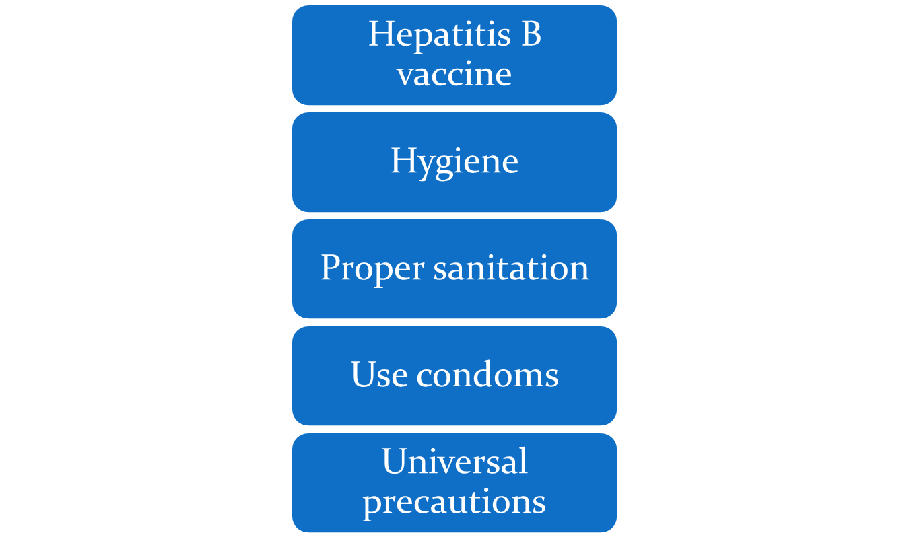
Prevention

Slide 182
Liver cirrhosis
Cirrhosis of the liver is characterized by scarring.
It is a chronic disease in which there has been diffuse destruction and fibrotic regeneration of hepatic cells.
As necrotic tissue is replaced by fibrotic tissue, normal liver structure and vasculature is altered, impairing blood and lymph flow, resulting in hepatic insufficiency and portal hypertension.

Slide 183
Classification
Alcoholic cirrhosis, in which the scar tissue characteristically surrounds the portal areas. This is most frequently due to chronic alcoholism and is the most common type of cirrhosis.
Postnecrotic cirrhosis, in which there are broad bands of scar tissue as a late result of a previous bout of acute viral hepatitis.

Slide 184
Classification
Biliary cirrhosis, in which scarring occurs in the liver around the bile ducts. This type usually is the result of chronic biliary obstruction and infection (cholangitis); it is much less common than the other two types.

Slide 185
Aetiology
Alcohol, Hepatitis B ± D, Hepatitis C are the most common causes.
Biliary cirrhosis
Autoimmune hepatitis
Hepatic venous congestion
Wilson’s disease
Drugs (e.g. methotrexate)
Cystic fibrosis
Idiopathic (cryptogenic)

Slide 186
Pathology
Destruction of Hepatocytes
Fibrosis/Scarring
Obstructed blood flow, increased venous Pressure
Portal Hypertenstion

Slide 187
Investigations
Liver biopsy detects destruction and fibrosis of hepatic tissue.
Liver scan shows abnormal thickening and a liver mass.
CT scan determines the size of the liver and its irregular nodular surface.
Esophagoscopy to determine esophageal varices.

Slide 188
Investigations
Paracentesis to examine ascitic fluid for cell, protein, and bacterial counts.
Laparoscopy and liver biopsy permit direct visualization of the liver.
Serum liver function test results are elevated.

Slide 189
Clinical Features
Compensated
  Intermittent mild fever
  Vascular spiders
  Palmar erythema (reddened palms)
  Unexplained epistaxis
  Ankle edema

Slide 190
Clinical Features
  Vague morning indigestion
  Flatulent dyspepsia
  Abdominal pain
  Firm, enlarged liver
  Splenomegaly

Slide 191
Clinical features
Decompensated
  Ascites, Jaundice, Weakness, Muscle wasting
  Weight loss
  Continuous mild fever
  Clubbing of fingers

Slide 192
Clinical Features
  Purpura (due to decreased platelet count)
  Spontaneous bruising
  Epistaxis
  Hypotension
  Sparse body hair
  White nails
  Gonadal atrophy

Slide 193
Clinical Features Contd…..
LIVER ENLARGEMENT
PORTAL OBSTRUCTION AND ASCITES
INFECTION AND PERITONITIS
GASTROINTESTINAL VARICES
EDEMA
VITAMIN DEFICIENCY AND ANEMIA
MENTAL DETERIORATION

Slide 194
Management
The management is usually Symptomatic.
Antacids to decrease gastric distress and minimize the possibility of GI bleeding.
Vitamins and nutritional supplements promote healing of damaged liver cells and improve the general nutritional status.

Slide 195
Management
Potassium-sparing diuretics (spironolactone )to decrease ascites, if present
An adequate diet and avoidance of alcohol are essential.
Although the fibrosis of the cirrhotic liver cannot be reversed, its progression may be halted or slowed by such measures.

Slide 196
Nursing Care/Nursing Diagnosis
Activity Intolerance related to fatigue, general debility, and discomfort.
Imbalanced Nutrition: Less Than Body Requirements related to anorexia and GI disturbances.
Impaired Skin Integrity related to edema, jaundice, and compromised immunologic status.

Slide 197
Nursing Care/Nursing Diagnosis
Risk for Injury related to altered clotting mechanisms
Disturbed Thought Processes related to deterioration of liver function and increased serum ammonia level.

Slide 198
Promoting activity Tolerance
Encourage alternating periods of rest and ambulation.
Maintain some periods of bed rest with legs elevated to mobilize edema and ascites.
Encourage and assist with gradually increasing periods of exercise.

Slide 199
Improving Nutrition
Eat high-calorie, moderate-protein meals and to have supplementary feedings.
Suggest small, frequent feedings and attractive meals in an aesthetically pleasing setting at mealtime.
Encourage oral hygiene before meals.
Administer or teach self-administration of medication for nausea, vomiting, diarrhea, or constipation.

Slide 200
Protecting skin integrity
Note and record degree of jaundice of skin and sclerae and scratches on the body.
Encourage frequent skin care, bathing without soap, and massage with emollient lotions.
Advise patient to keep fingernails short.

Slide 201
Preventing injury through bleeding
Observe stools and emesis for color, consistency, and amount.
Be alert for symptoms of anxiety, epigastric fullness, weakness, and restlessness, which may indicate GI bleeding.
Observe for external bleeding: ecchymosis, leaking needle stick sites, epistaxis etc.

Slide 202
Preventing injury through bleeding
Keep patient quiet and limit activity if signs of bleeding exhibited.
Administer vitamin K as prescribed.
Encourage intake of foods with high vitamin C content.

Slide 203
Preventing injury through bleeding
Stay in constant attendance during episodes of bleeding. Institute and teach measures to prevent trauma:
  Maintain safe environment.
  Gentle blowing of nose.
  Use of soft toothbrush.
Use small-gauge needles for injections, and maintain pressure over site until bleeding stops

Slide 204
Promoting improved thought Process
Restrict high-protein loads while serum ammonia is high to prevent hepatic encephalopathy.
Monitor ammonia levels.
Prevent infection
Monitor fluid intake and output and serum electrolyte levels to prevent dehydration and hypokalemia, which may precipitate hepatic coma.

Slide 205
Promoting improved thought Process
Keep environment warm and limit visitors.
Pad the side rails of the bed and provide careful nursing surveillance to ensure patient's safety.
Assess LOC and frequently reorient as needed.
Administer lactulose for elevated ammonia levels and decreasing LOC

Slide 206
Complications
Hyponatremia and water retention.
Bleeding esophageal varices.
Coagulopathies.
Spontaneous bacterial peritonitis.
Hepatic encephalopathy, which may be precipitated by the use of sedatives, high-protein diet, sepsis, or electrolyte imbalance.

Slide 207
Portal Hypertension
Obstructed blood flow through the damaged liver results in increased blood pressure (portal hypertension) throughout the portal venous system.
Although portal hypertension is commonly associated with hepatic cirrhosis, it can also occur with non-cirrhotic liver disease.

Slide 208
Portal Hypertension
Two major consequences of portal hypertension are;
    ascites and
    varices.
In ascites, fluid accumulates in the abdominal cavity.

Slide 209
Portal Hypertension
Varices are varicosities that develop from elevated pressures transmitted to all of the veins that drain into the portal system.
They are prone to rupture and often are the source of massive hemorrhages from the upper GI tract and the rectum.
Blood clotting abnormalities, often seen in patients with severe liver disease, increase the likelihood of bleeding.

Slide 210
Hemorrhoids
These are varicose veins in the anal canal.
Those occurring above the internal sphincter are referred to as internal haemorrhoids and those appearing outside the external sphincter are called external haemorrhoids

Slide 211
Clinical features
Itching,
Bleeding during bowel movements
Pain.
Internal haemorrhoids are usually not painful until they prolapse or bleed due to enlargement.

Slide 212
Management
Symptoms of discomfort are relieved by personal hygiene and avoiding excessive straining during defaecation.
Straining can be reduced through intake of a diet that contains roughage and increased fluid intake.

